Slide 1
Improving Motor Imagery Brain Computer Interface Classification
Group 1
Micah Baldonado, Dheemant Jallepalli, Defne Kudug, Alexis Valencia, Joseph Zhang, J.D. Kline

Slide 2
Introduction

Slide 3
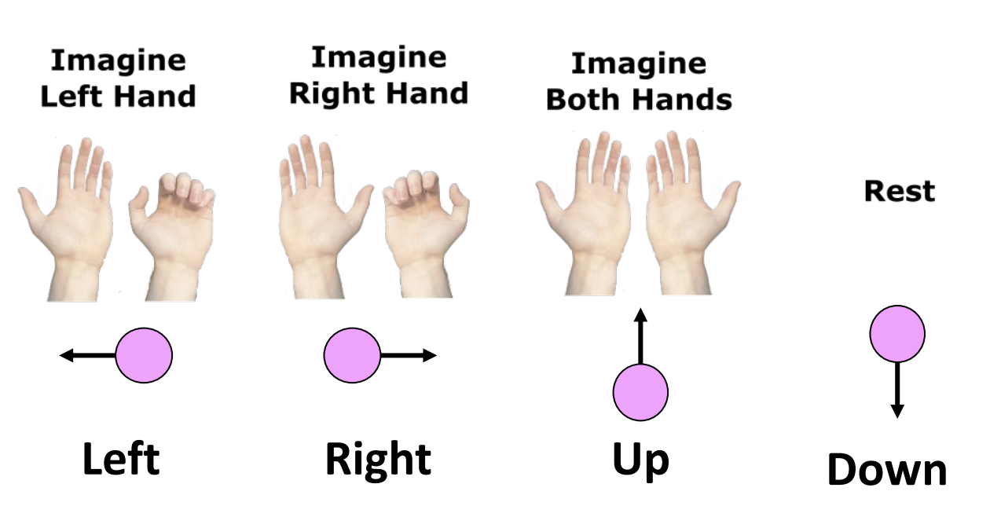
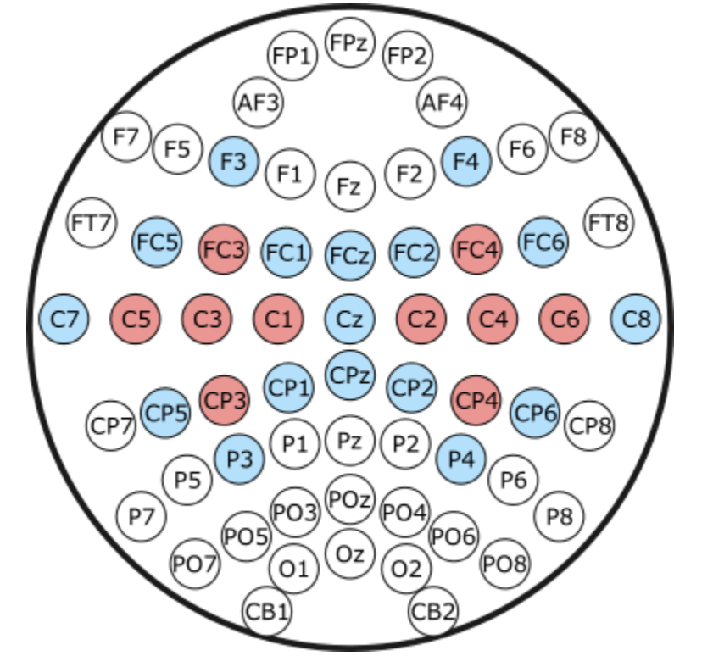
Experiment Background
Motor imagery (MI) task:
Participant imagines moving left vs. right hand, and both (up) vs. none (down) in the other experiment, without actual movement.
MI modulates the sensorimotor rhythm (SMR): – Mu (8–13 Hz) and beta (13–30 Hz) over the sensorimotor cortex. – Imagining right-hand movement → ERD (power decrease) over C3; imagining left-hand movement → ERD over C4.
Electrode montage:
64-channel cap; analysis focuses on sensorimotor channels.
Online BCI (red electrodes): small set around C3 and C4 used in real time.
Offline analysis (red + blue): extended set of ~27 gelled channels over FC–C–CP rows to capture more spatial information.
“Motor imagery changes alpha/mu power over contralateral sensorimotor cortex; we record from C3/C4-centered electrodes to capture these SMR changes.”
Notes:
In our experiment, participants performed motor imagery, meaning they imagined moving their left hand, right hand, both hands, or staying at rest. Importantly, this is imagined movement only—no actual muscle contractions.
Motor imagery modulates the sensorimotor rhythm, specifically the mu band (8–13 Hz) and beta band (13–30 Hz) over the sensorimotor cortex. When someone imagines moving the right hand, we typically see an ERD—event-related desynchronization—at C3, which is the left-hemisphere motor area. Imagining the left hand causes ERD in C4, the right hemisphere.
So our whole decoding problem essentially becomes: detecting these alpha/mu power decreases at the correct electrode for the imagined hand.
For electrode placement, we used a 64-channel EEG cap, but online we only used a small, fast set of electrodes—those highlighted in red near C3 and C4—because online decoding has to be real-time and low-latency.
For offline analysis, we also included the blue electrodes, which adds over 20 more surrounding channels. This larger spatial coverage lets us extract richer information from the sensorimotor area and improves our offline performance.

Slide 4
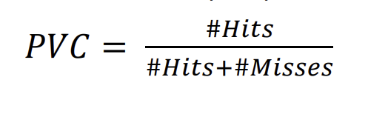
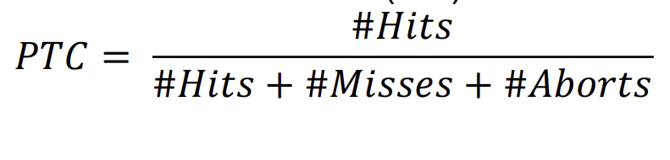
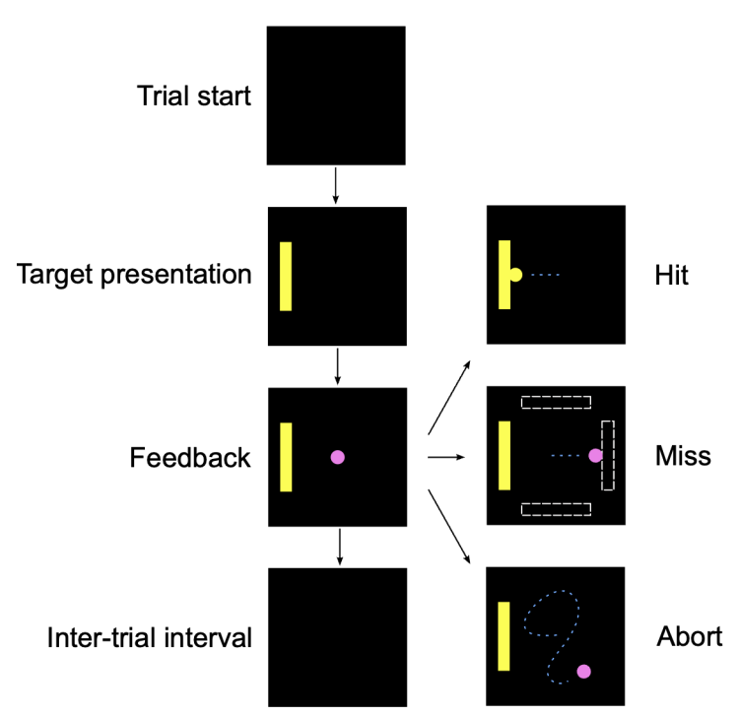
PVC vs PTC and Online Classifier
PTC (Percent Total Correct): overall behavioral score – % of all trials where the final cursor/ball ends on the correct target (aborts counted as incorrect).
PVC (Percent Valid Correct): classifier-centric score – % of hit vs. miss trials where the online classifier sends the cursor in the correct direction (aborted trials ignored).
Online linear classifier: simple FT+LDA (using Burg AR) to estimate C3/C4 alpha power and their difference, then a 1-D LDA decides left vs. right (or up vs. down).
Why we use PVC: our offline models are also evaluated on non-aborted trials only, so using PVC (and skipping aborted trials) makes our performance directly comparable to the original online linear classifier.
Notes:
During each trial, the participant moves a cursor using motor imagery. The outcome can be a hit, miss, or abort.
From these outcomes, we compute two metrics:
PVC, Percent Validation Correct, measures the proportion of hit vs miss trials—so aborted trials are ignored. This is the metric the online system uses because the online classifier only outputs a direction, not an abort.
PTC, Percent Total Correct, is more strict. It includes everything: hits, misses, and aborts.
For comparing our offline decoders to the online one fairly, we primarily use PVC, because both operate on the same two classes: left vs. right or up vs. down.
The online classifier itself is extremely simple. It uses a short-time Fourier transform plus LDA, and estimates alpha power using the Burg autoregressive estimator. The classifier looks only at C3 and C4, computes their alpha-band power, takes the difference, and then a 1-D LDA decides the direction.
So for example, if alpha power decreases over C3 relative to C4, it interprets that as right-hand motor imagery.

Slide 5
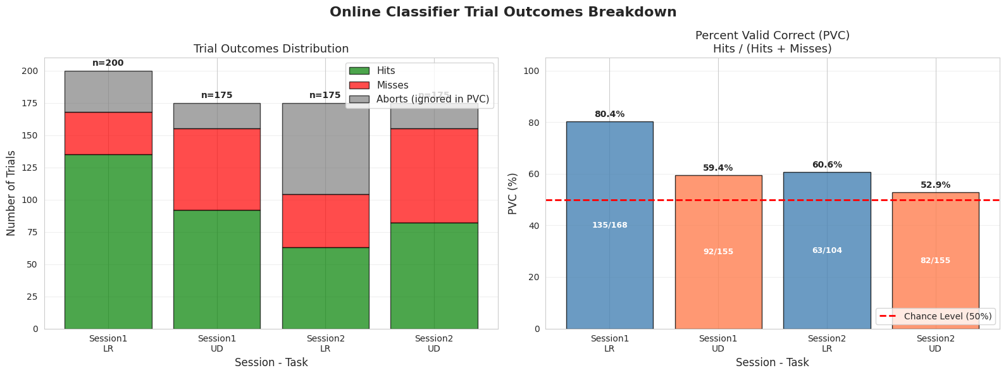
Online Performance
Notes:
JD
We chose to evaluate our models using PVC. PTC requires the classifier to have the ability to abort a trial, which is not useful for binary classifiers that are used in offline classifiers. PVC requires the exclusion of aborted trials, which can limit the training data available for the model. Overall, aborted trials are relatively uncommon in the dataset, but for some sessions they occupy a greater proportion of the trial number, potentially leading to session bias.
Since we are using PVC, this limits our dataset given our need to remove aborted trials. In session 2 left and right discrimination, more than a quarter of trials were aborted. What this also means is potential bias toward some sessions over others, with session 1 left and right discrimination having a third more

Slide 6
Preprocessing + Feature Selection

Slide 7
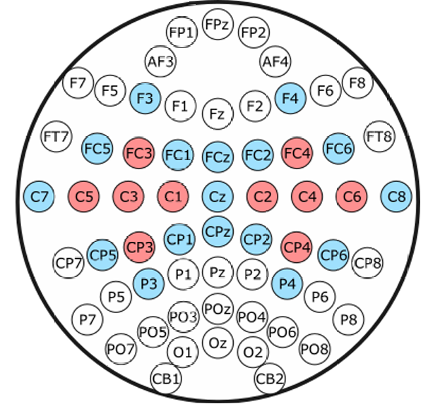
Preprocessing
Selecting Motor ROI
Bandpass
(~8-30 Hz)
CAR
Down-
sampling
Data
Epochs
Optional:
Laplacian
ICA
Epoch exclusion criteria (too short, trial aborted)
Notes:
JD
Sometimes only between 50-70 trials remain.
top row, basically everyone will do
bottom row, kind of optional
TOP:
By selecting motor ROI, this really means that we select the 27 gelled electrodes.
Bandpass removes low-frequency drift and also high-frequency noise like 60 Hz line noise.
Most of us used 8-30. 4-40 is also common.
Common Average Referencing CAR = remove the common noise in the electrodes. If a signal happens in all electrodes, it is unlikely to be a meaningful brain signal.
downsampling: it makes the processing takes too long.
BOTTOM:
EPOCH EXCLUSION: we lose A LOT OF TRIALS from doing this
We exclude aborted trails BECAUSE we want a fair comparison to our binary classifier models
We also exclude trials based on the time frame. For example, we set a minimum length for trials. We exclude all trials that are shorted than this because then the classifier wouldn’t have enough data to train on.
Independent component analysis ICA - Is a technique used to find dimensions that are completely statistically independent.
Laplacian - signal processing technique that acts as a spatial filter to reduce noise of EEG by calculating the spatial derivative of the EEG signal and isolate activity from common artifacts.

Slide 8
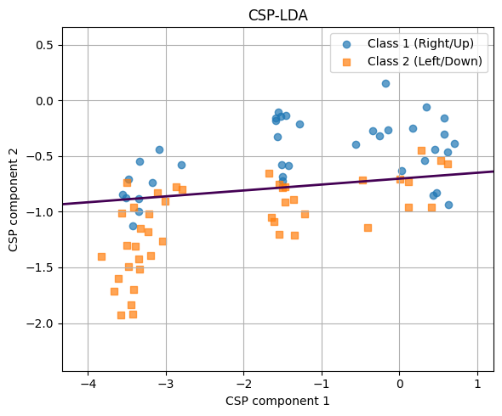
Common Spatial Pattern
CSP identifies spatial filters with maximal variance for one class and minimal variance for the other, enhancing discriminative features.
Motor imagery produces distinct spatial patterns in mu (8–13 Hz) and beta (13–30 Hz) rhythms over sensorimotor cortex.
The EEG is often band-pass filtered into multiple frequency bands (e.g., filter bank CSP) to capture band-specific discriminative features.
Notes:
Alexis - ~30 sec

Slide 9
Filter Bank CSP (FBCSP)
.
.
.
Bandpass
Filter
Traditional CSP per frequency band
Feature Selection:
Mutual Information-Based Best Individual Feature (MIBIF)
4-8 Hz
8-12 Hz
Data
Classification
36-40 Hz
Notes:
Joseph
Traditional CSP is already quite strong for our simple motor imagery task, but there has been work to improve the discriminative power of CSP features.
One method is known as filter bank CSP or FBCSP.
This method involves first band-passing the data into multiple different sub-bands such as 4-8 Hz, 8-12 Hz, etc., and then running CSP on each of those bands.
This produces a lot of features, so in order to not overwhelm the classifier with potentially noisy features, we also include feature selection.
There are many feature selection methods, but the one that has traditionally found a lot of success with FBCSP is mutual information-based best individual feature or MIBIF.
Mutual information is the amount of information a feature provides about a class label. So the higher the mutual information, the more useful the feature. We then select the top k features with the highest mutual information and pass those to our classifier.
This helps us turn what begins as several dozen or hundreds of CSP features into around 10 useful ones. Ideally, these will correspond to the individual mu and beta band ERDS phenomenon.

Slide 10
Classifiers

Slide 11
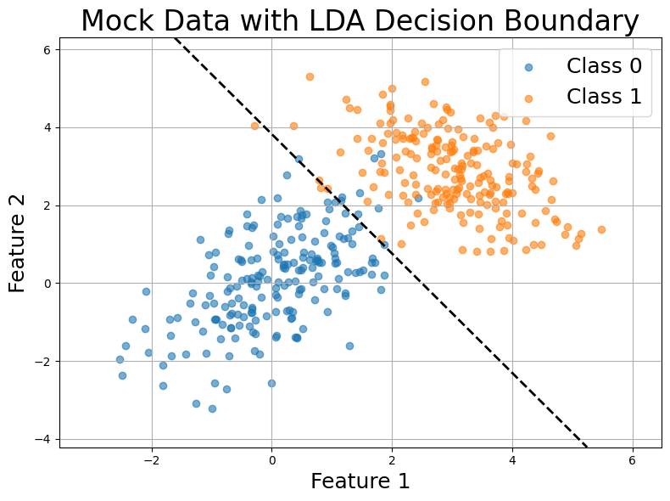
Classifiers
Linear Discriminant Analysis (LDA)
Computes the different means and shared covariance of given classes,
and then finds the projection that maximizes the separation of the means, but minimizes the within-class variance.
Shrinkage LDA (sLDA)
If the number of features is large, but the number of samples is low, then the covariance matrix is unstable.
Replace covariance matrix in LDA with Σ_{λ}​=(1−λ)Σ+λI → Make it more spherical.
Notes:
Joseph
After determining our features, we need to build a classifier to distinguish classes based on them.
For CSP, one of the most common and accurate techniques is linear discriminant analysis or LDA.
LDA works by finding a projection that maximizes the separation of the class means while minimizing the within-class variance, and then getting the decision boundary which is perpendicular to that line.
An example of this decision boundary can be seen on this figure on the right.
However, sometimes the covariance matrix is unstable because we might have too many features and not enough data.
This is where shrinkage LDA or sLDA can come in to help.
sLDA replaces the covariance matrix with one that is more spherical, and it applies heavier regularization the more noisy the covariance is.

Slide 12
Classifiers
Support Vector Machine (SVM)
Maximize distance between decision boundary and closest points of each class.
Better when the features are not Gaussian or have equal covariance.
→ Generally, these classifiers all perform at around the same level.
Random Forest (RF)
Random Forest is an ensemble method that trains many decision trees on bootstrapped subsets of the data and uses random subsets of features at each split. Each tree votes on the class label, and the final prediction is the majority vote. RF can model complex non-linear decision boundaries, is relatively robust to noise and overfitting, and works well when there are many input features without strong assumptions on their distribution.
Notes:
Joseph (SVM), RF (Defne)
SVM
Another common classifier for BCIs is the support vector machine or SVM.
Instead of maximizing the distance in means, SVM tries to maximize the distance between the decision boundary and the closest points between the classes.
This is useful when the features are not Gaussian or have equal covariance, which typically CSP does have but we also try other features that may not satisfy these requirements.
RF:
RF is an ensemble of many decision trees trained on bootstrap samples of the data. Each tree learns different subsets of trials and different subsets of features, and the final prediction is made by majority vote.
Random Forest works especially well for EEG because the data are noisy and high-dimensional, and RF doesn't assume Gaussianity or linear separability. It can model more complex, nonlinear boundaries than LDA, while still being robust against overfitting.

Slide 13
CSP/FBCSP Results

Slide 14
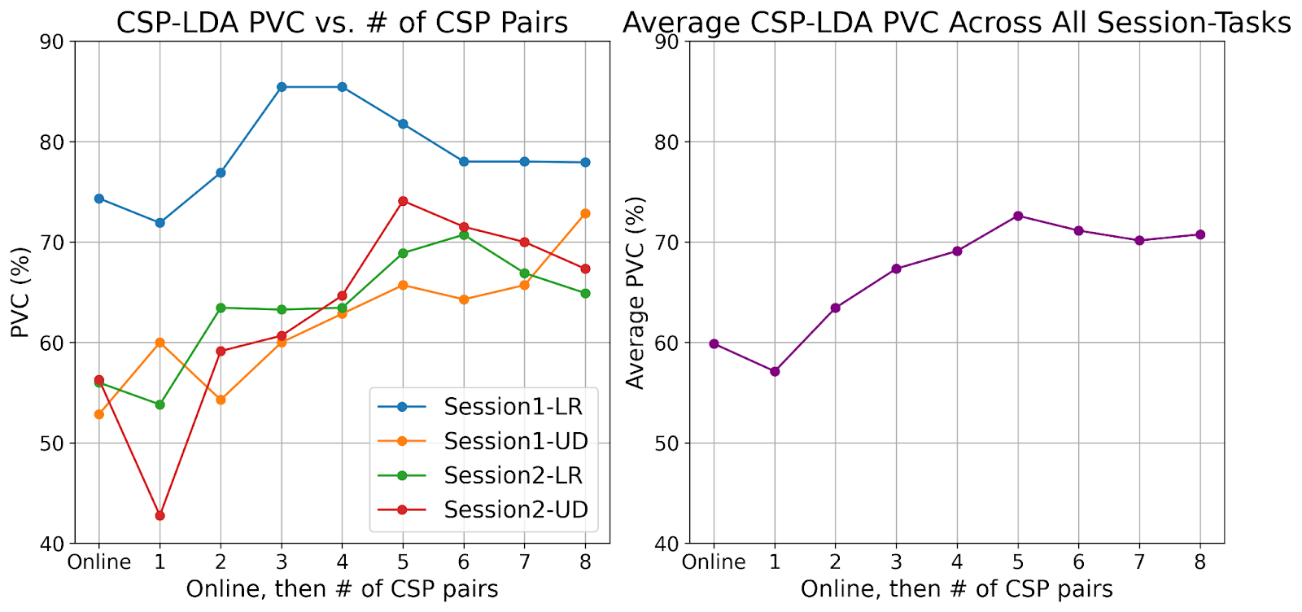
Exploring Impact of # of CSP Pairs
5 pairs of CSP features is optimal.
Behavior is consistent between session-tasks.
Notes:
Joseph

Slide 15
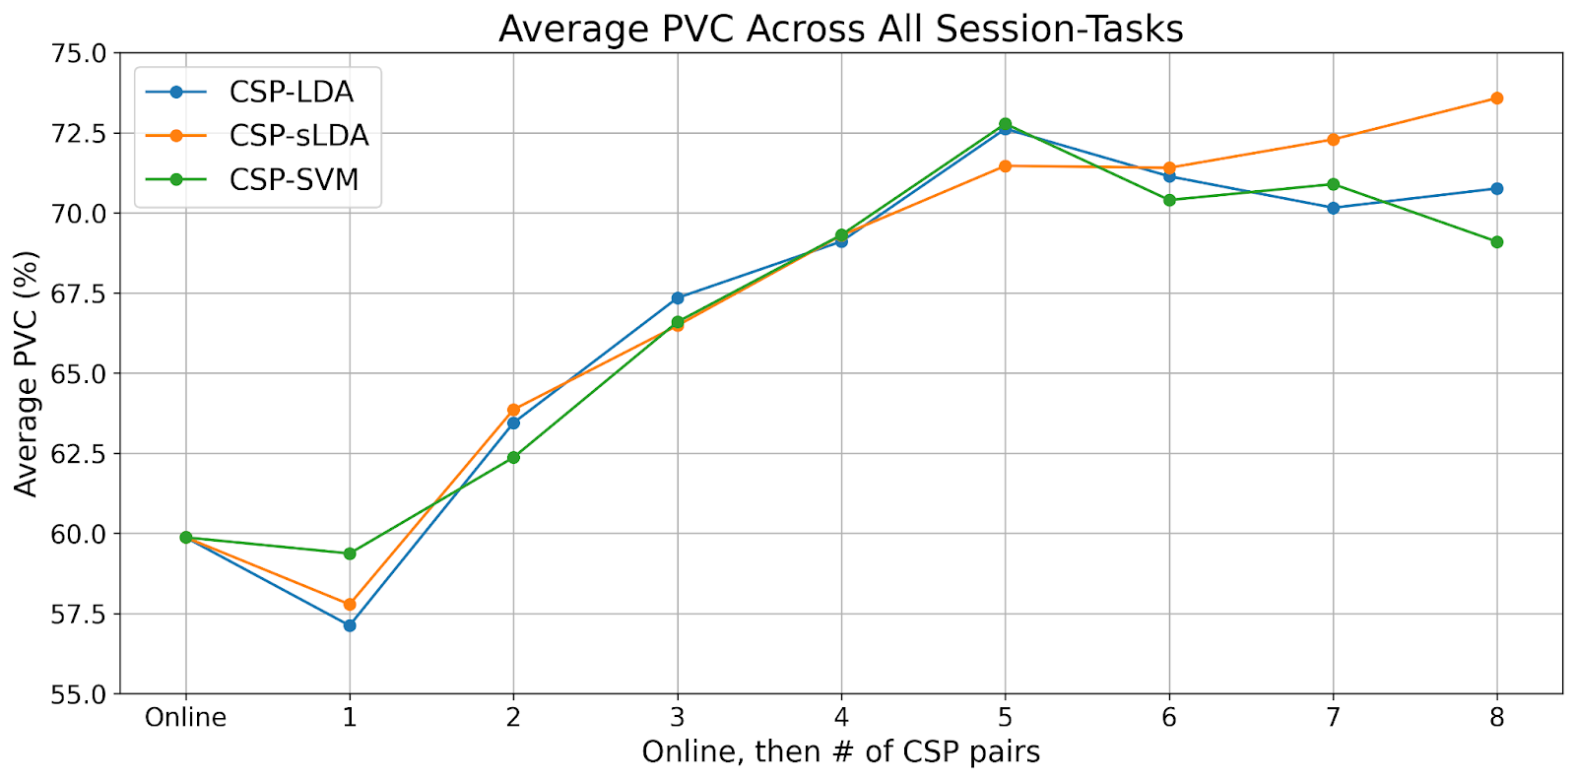
Comparing Different Classifiers
SVM performs the best at 5 CSP pairs.
sLDA seems to overfit as PVC continues to climb unexpectedly.
LDA or SVM are most suitable for CSP.
Notes:
Joseph

Slide 16
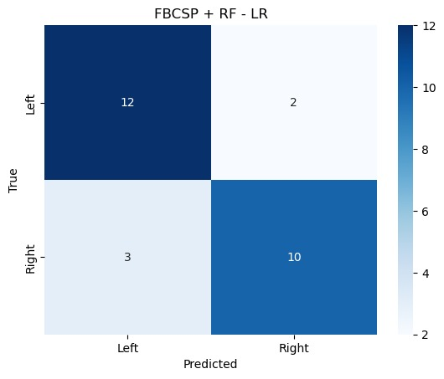
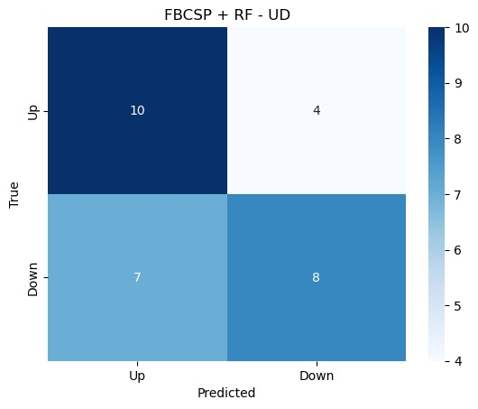
Applying FBCSP Features to a RF Model
Separating CSP features by frequency bands per task gives us higher PVC for a single task:
LR task: 81.5%
UD task: 62.1%
UD task suffers as it evenly classifies down as up.
Notes:
Joseph

Slide 17
Deep Learning

Slide 18
Neural Networks and BCI
Neural networks are black boxes, not very interpretable
Can make their own features from the data. They can also classify based on existing features
Computational cost of neural network architectures is high, especially during training
Subject specificity in deep learning often dominates performance
When we rejected all trials that were smaller than 1500 samples, this resulted in only keeping 329 valid trials total. This is NOT a lot of data to work with in a deep learning setting
This lead to high regularization required if learning from EEG data directly
Deep learning achieves state of the art performance

Slide 19
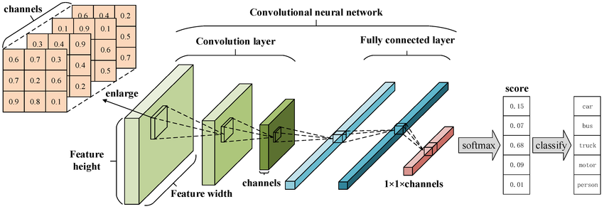
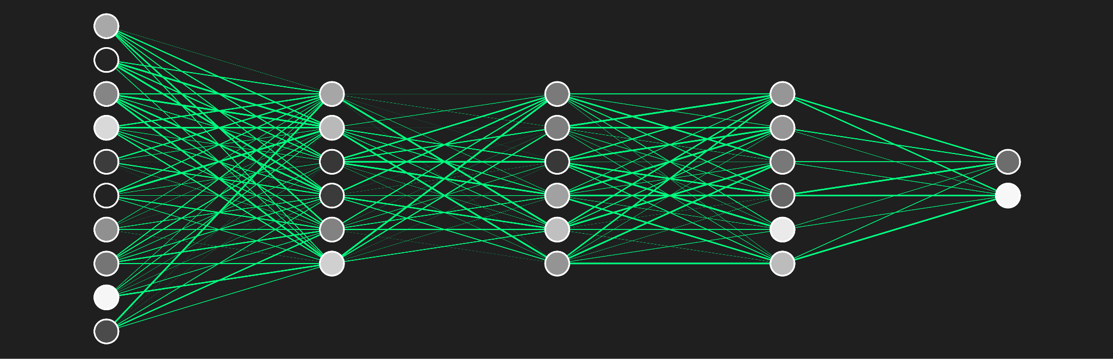
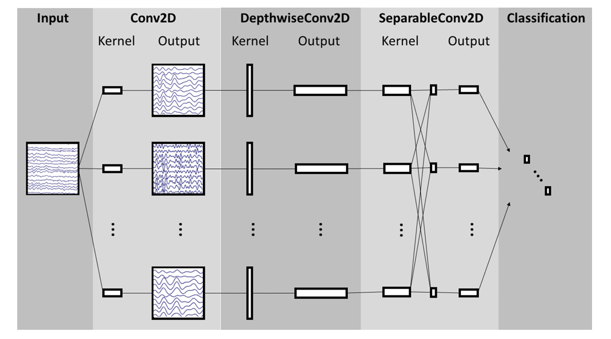
Neural Network
There a huge variety in flavor of neural networks
3) CNN
CSP
1)
CSP
CNN
MLP
CSP
4)
raw EEG data
2)
raw EEG data
Feature-fusion network
EEGNet (Lawhern et al., 2018)
Notes:
WHY do we use Deep learning in this project?
We use deep learning because neural networks create features which other models often miss, even as a consequence of its interpretability.
For example, by attaching an MLP to CSP features, we can find non-linear patterns that are not easily found by LDA which linearly separates classes
Neural networks also have the ability to have preprocessing and feature extraction built within which allow them to process raw EEG data directly as we’ll see with EEGNet.
Another type of model is feeding CSP features into a CNN. The beauty of a CNN is its ability to learn temporal patterns. Because CSP features are still time-series data, CNNs can learn long term patterns which MLPs often miss.
A CSP feature is still a time series, and a CNN is built to read patterns that unfold over time. An MLP ignores order.
An MLP would just stack
Another type of network would be one that stacks CSP and raw EEG data into a single tensor, taking advantage of hand-crafted CSP spatial features and the raw EEG data for a more sophisticated analysis. While our team did not implement this directly, such networks are possible with modern deep learning architectures.

Slide 20
EEGNet
EEGNet is built analogously to EEG processing
input: raw EEG data
requirements: preprocessed signal
Temporal Convolution→ Band Pass Filter
Depthwise Convolution → Spatial Filtering (CSP-like)
Classification → Simple Classifier model (e.g. LDA)
(Lawhern et al., 2018)
Notes:
Deep Convolutional Neural network that takes raw EEG data
VERY SIMILAR TO FILTER BANK CSP

Slide 21
Deep Learning Results

Slide 22
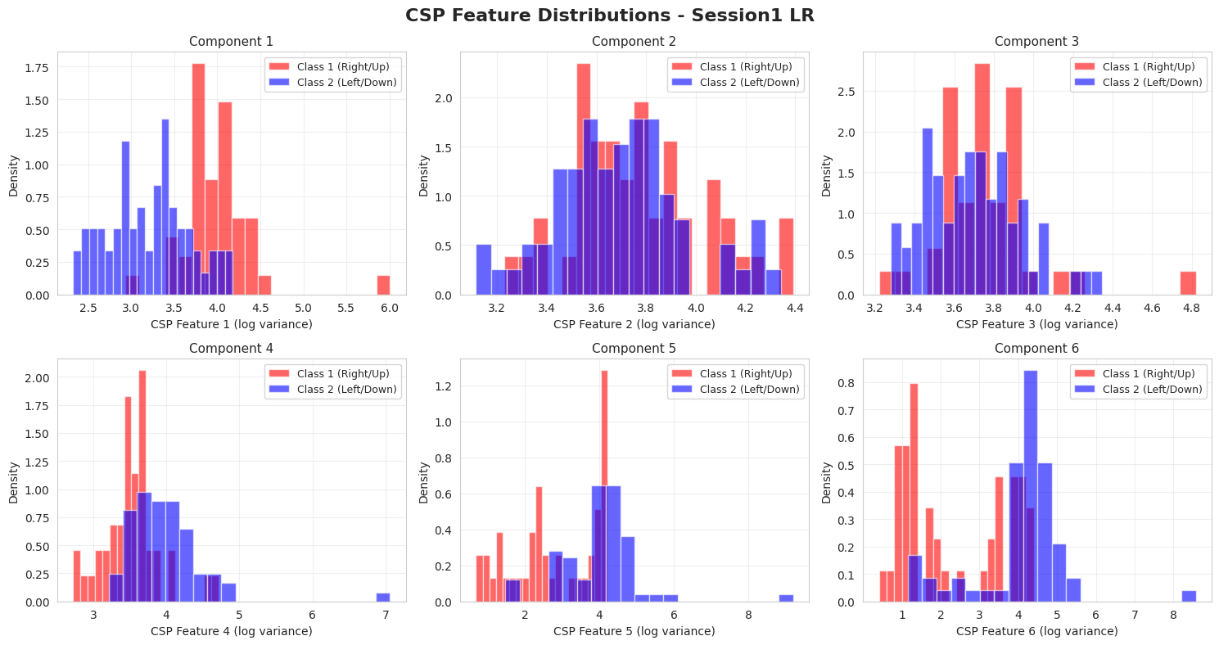
Subject 1 (LR Task)
Histograms show the log-variance of six CSP components for Class 1 (Right) and Class 2 (Left).
Clear separation in several components indicates effective spatial filtering and discriminative power between motor-imagery classes.

Slide 23
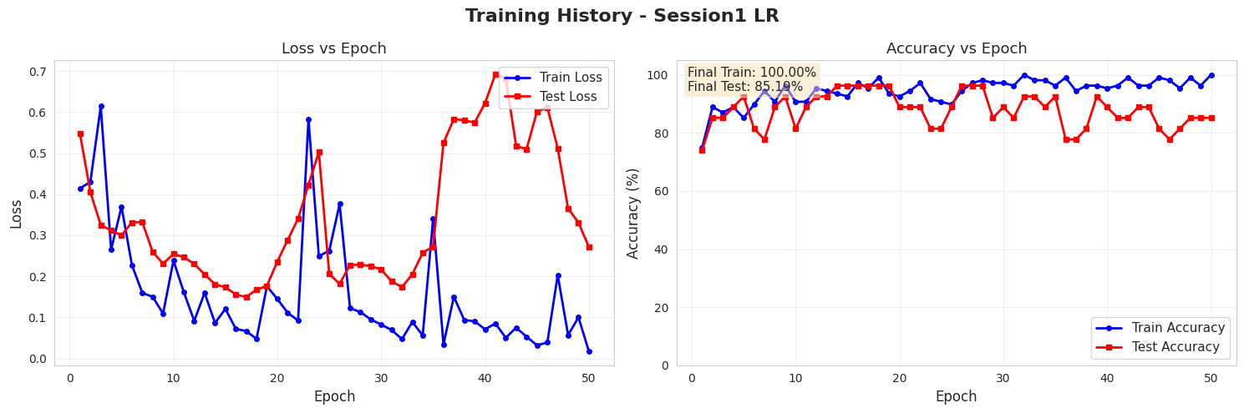
Subject 1 (LR Task)
The left panel shows training and test loss over 50 epochs, indicating stable convergence but some oscillation in test loss. The right panel shows accuracy curves, with training accuracy reaching 100% and test accuracy stabilizing around ~85%, suggesting mild overfitting but good generalization overall.

Slide 24
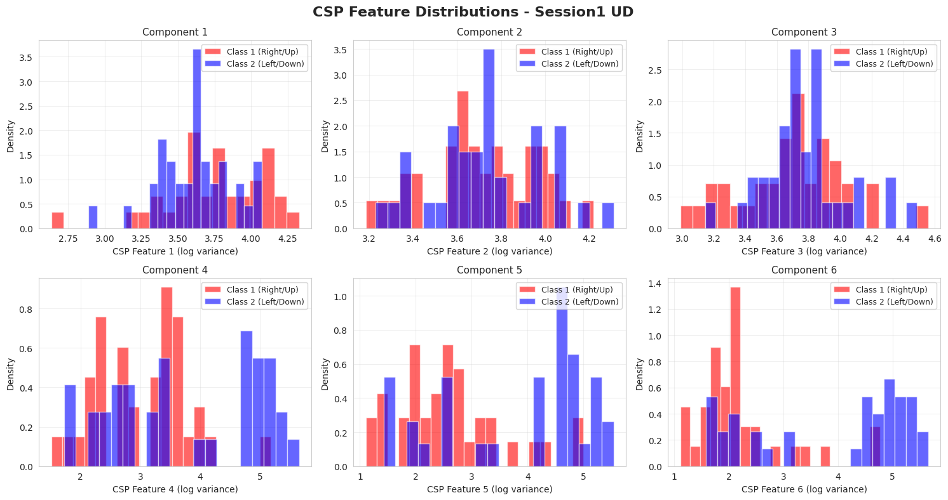
Subject 1 (UD Task)
Histograms show the log-variance of six CSP components for Class 1 (Up) and Class 2 (Down).
Clear separation in several components indicates effective spatial filtering and discriminative power between motor-imagery classes.

Slide 25
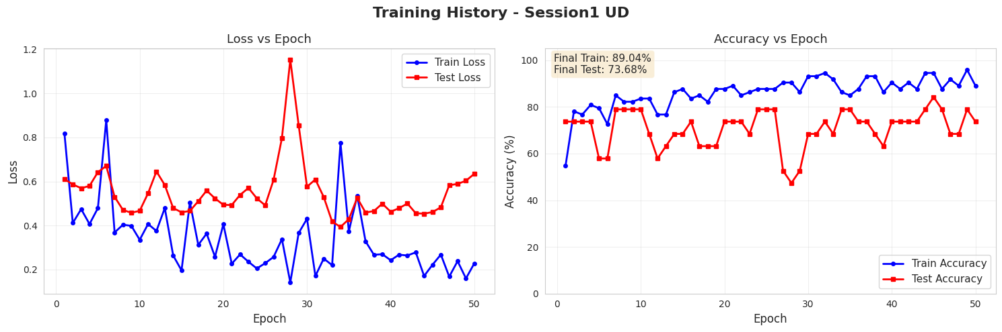
Subject 1 (UD Task)
The left panel shows training and test loss over 50 epochs, indicating stable convergence but some oscillation in test loss. The right panel shows accuracy curves, with training accuracy reaching 89% and test accuracy stabilizing around ~73%

Slide 26
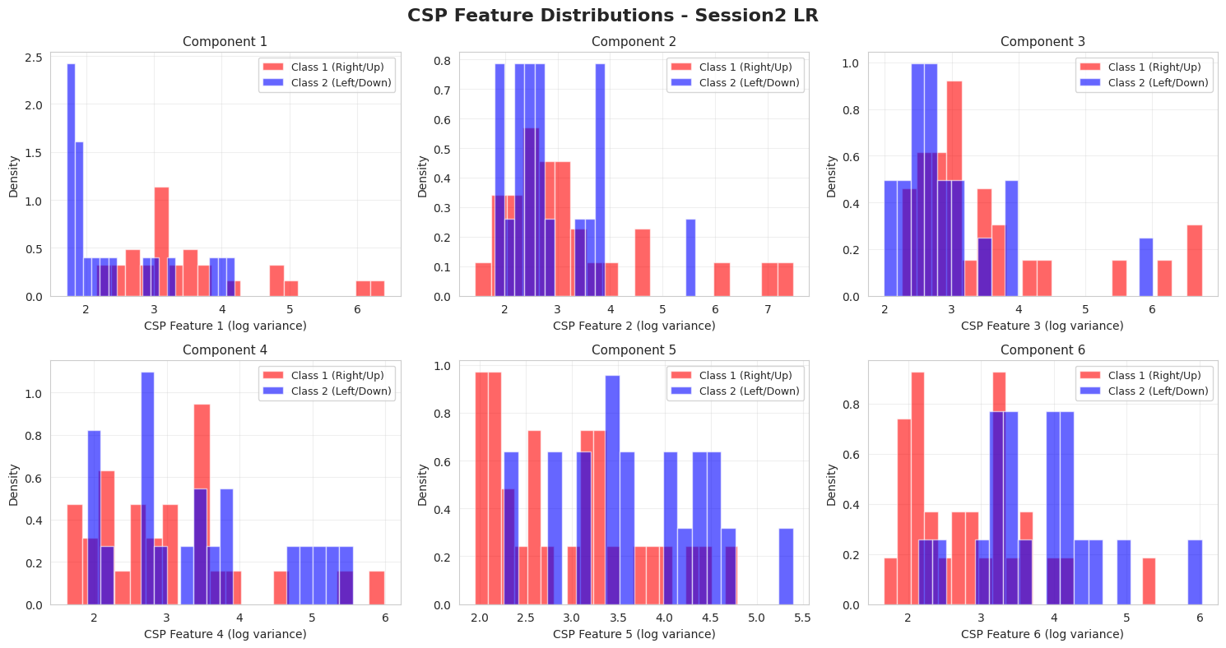
Subject 2 (LR Task)
Histograms show the log-variance of six CSP components for Class 1 (Right) and Class 2 (Left).
Clear separation in several components indicates effective spatial filtering and discriminative power between motor-imagery classes.

Slide 27
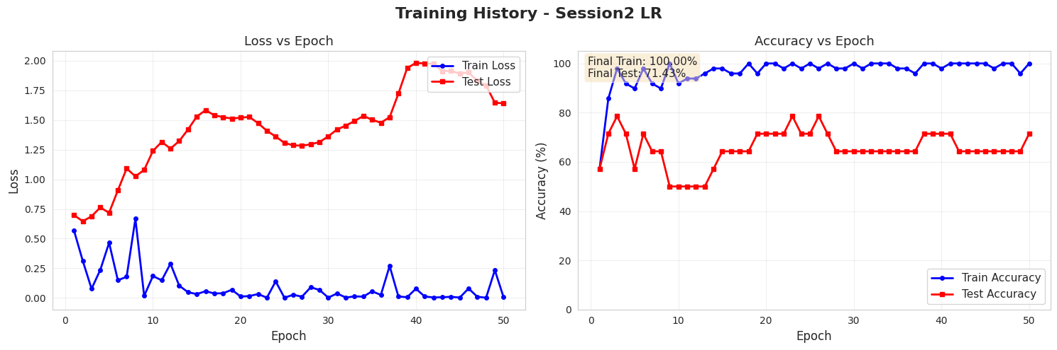
Subject 2 (LR Task)
The left panel shows training and test loss over 50 epochs, indicating stable convergence but some oscillation in test loss. The right panel shows accuracy curves, with training accuracy reaching 100% and test accuracy stabilizing around ~71%, suggesting mild overfitting but good generalization overall.

Slide 28
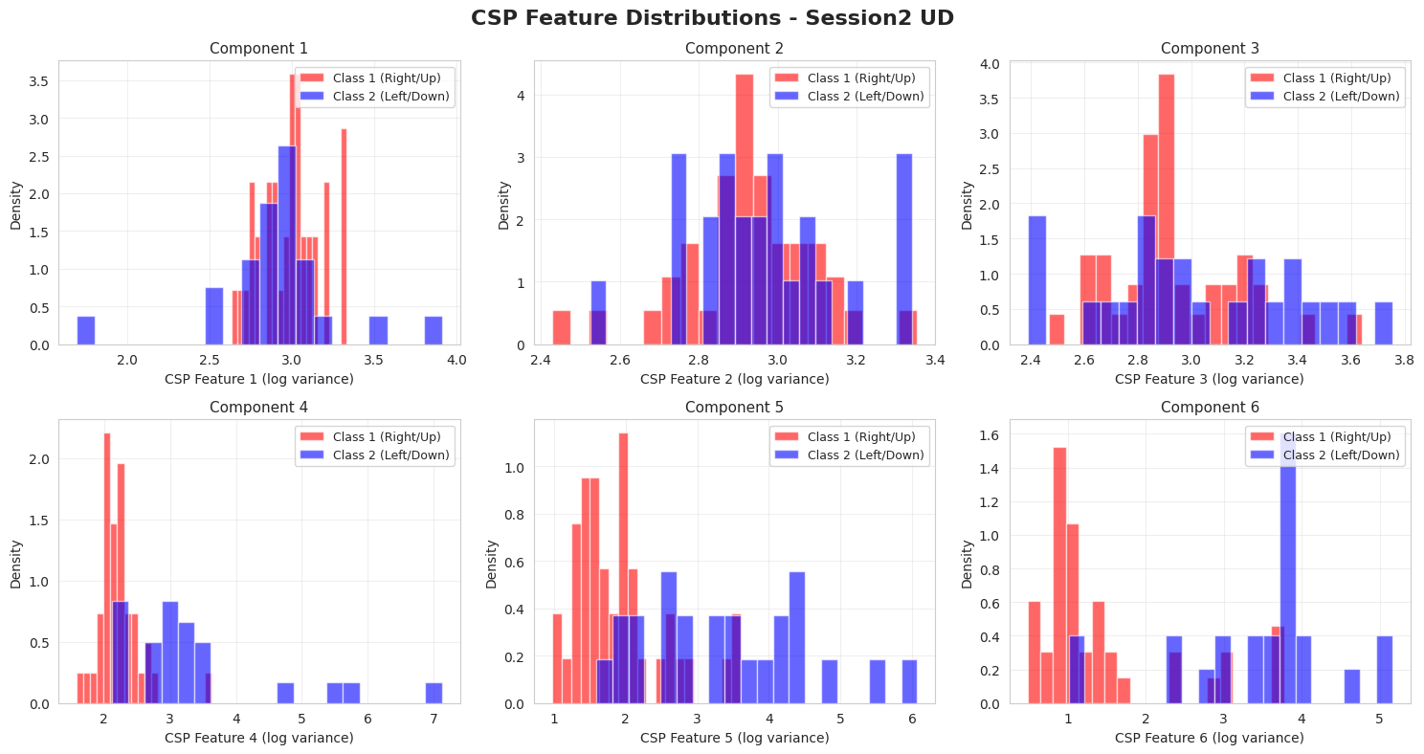
Subject 2 (UD Task)
Histograms show the log-variance of six CSP components for Class 1 (Up) and Class 2 (Down).
Clear separation in several components indicates effective spatial filtering and discriminative power between motor-imagery classes.

Slide 29
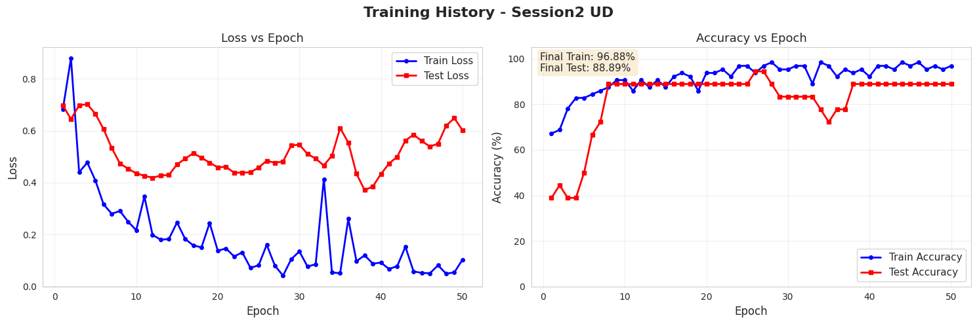
Subject 2 (UD Task)
The left panel shows training and test loss over 50 epochs, indicating stable convergence but some oscillation in test loss. The right panel shows accuracy curves, with training accuracy reaching ~97% and test accuracy stabilizing around ~89%, suggesting mild overfitting but good generalization overall.

Slide 30
Summary of
Best Models

Slide 31
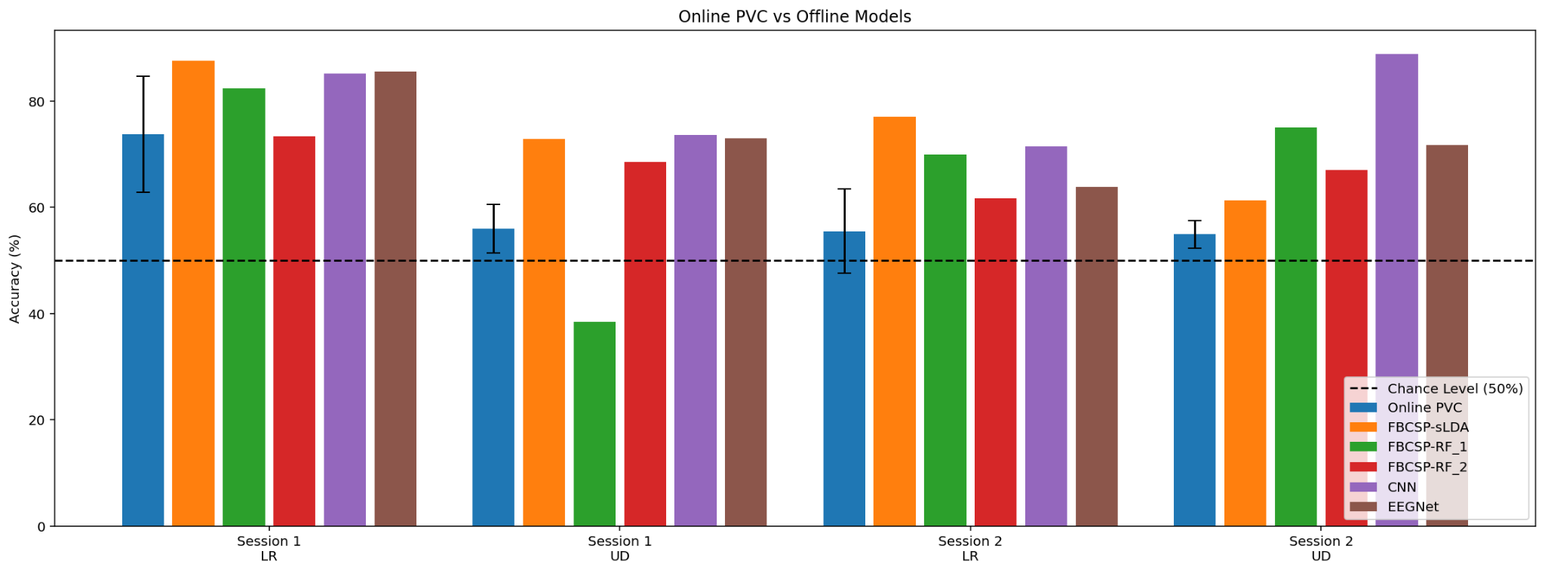
Final PVC Performance

Slide 32
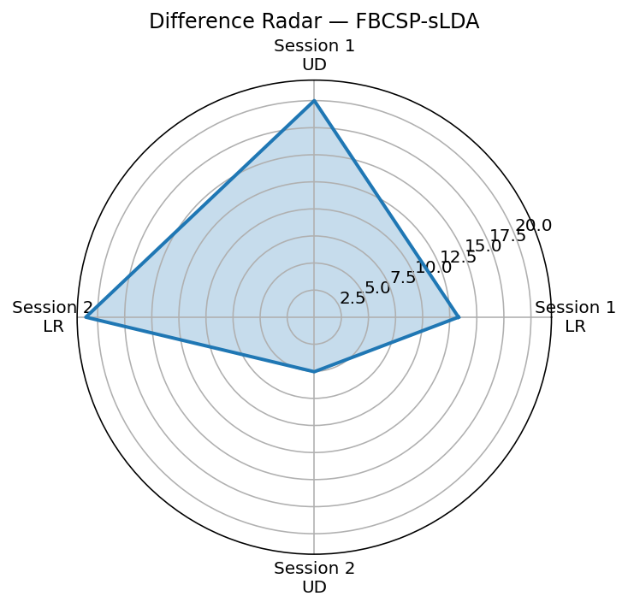
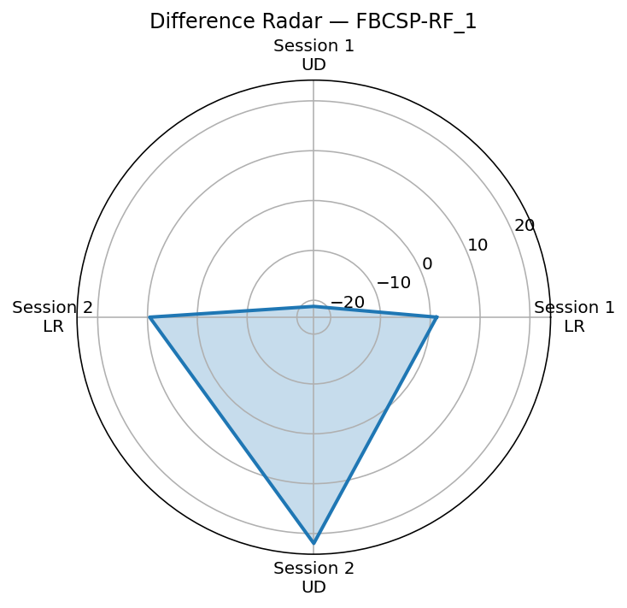
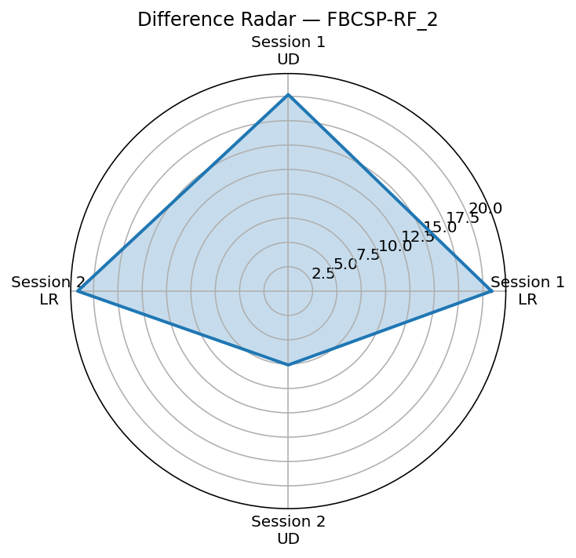
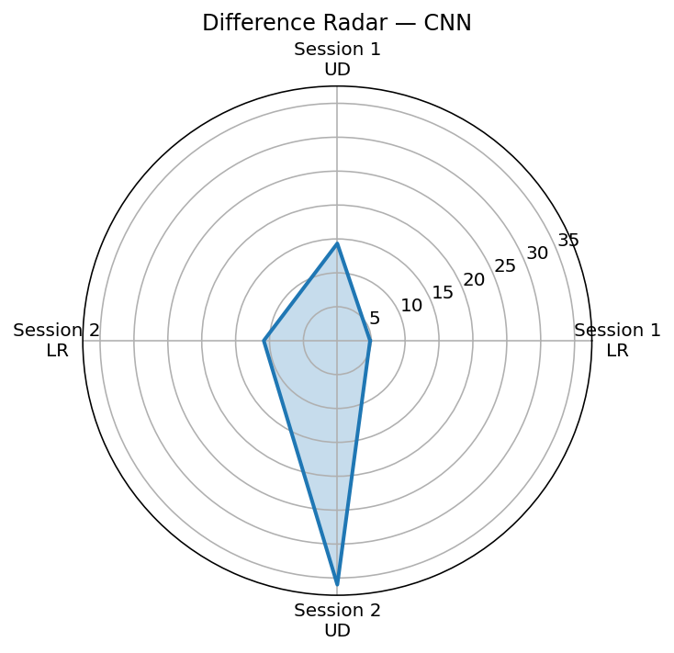
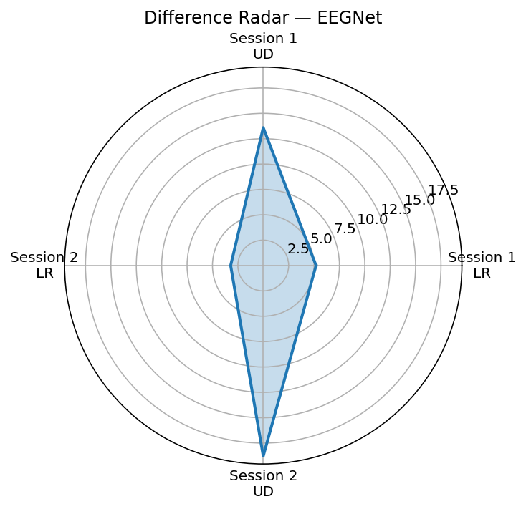
Difference Radar Between Online & Offline PVC

Slide 33
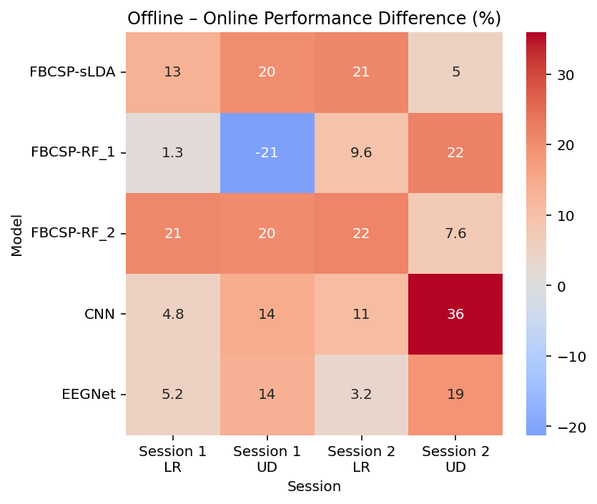
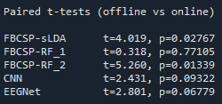
Difference Radar Between Online & Offline PVC
Notes:
Our best-performing decoder was the Filter Bank CSP (FBCSP) combined with a Random Forest classifier. The FBCSP stage extracts discriminative frequency- and spatial-domain features by applying CSP separately in three SMR sub-bands (8–13, 13–20, 20–30 Hz), yielding a 24-dimensional log-variance feature vector that captures motor imagery–specific mu/beta desynchronization across sensorimotor cortex. Random Forest provides a robust nonlinear classifier that is well-suited to EEG: it handles the noisy and highly variable CSP features, models nonlinear relationships across frequency bands, and remains stable under the small trial counts in our dataset. Using 300 trees with class-balanced weighting, the FBCSP–RF model consistently exceeded all other offline decoders in our pipeline, achieving an average accuracy of 67.66%, substantially outperforming both the online PVC baseline and the linear CSP/LDA variants.

Slide 34
Conclusion

Slide 35
Conclusion
In general, across all models, our offline models outperformed the online classifier.
Why? CSP/FBCSP can learn spatial patterns between multiple electrodes.
Deep learning performs better as they can learn non-linear relationships within the data that the online classifier and CSP classifiers cannot.
No single model won outright. CSP/FBCSP + LDA models performed similar to our top performing models.
In the field of BCI, preprocessing drives performance.

Slide 36
Limitations and Future Work
Data leakage
EEG is time-series, and we perform 5-fold cross validation, mixing in trials across time.
Proper validation requires having designated training and testing sections during experimentation.
However, we are limited by small dataset so only testing with one chronological split would likely lead to unstable PVC and overfitting.
Future work
Implement online versions of these classifiers to address data leakage.
Test on more subjects to improve model generalizability.

Slide 37

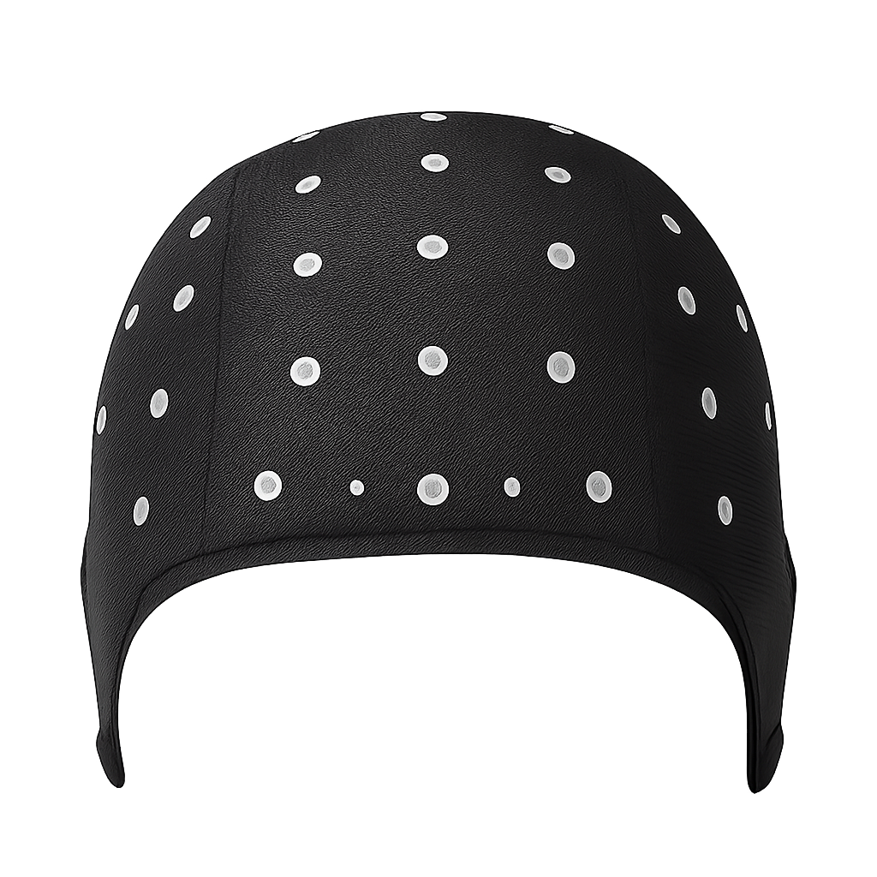
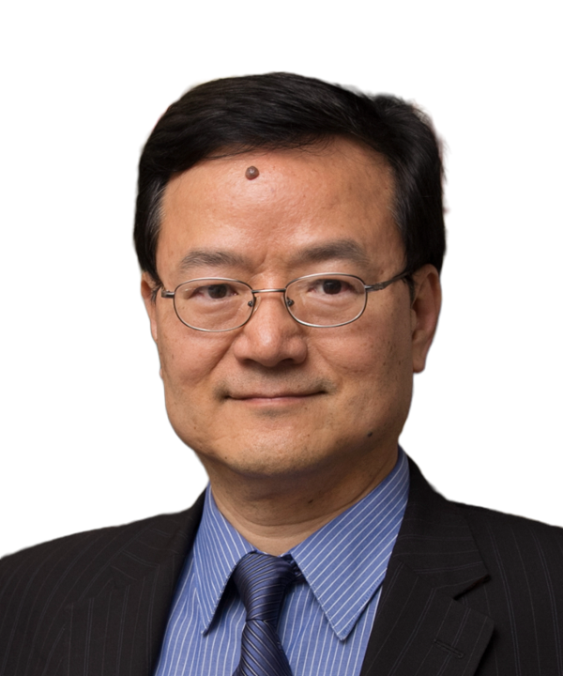

Thank you so much to Dr. He and Yidan for their help on this project!

Slide 38
References
Lawhern, V. J., Solon, A. J., Waytowich, N. R., Gordon, S. M., Hung, C. P., & Lance, B. J. (2018). EEGNet: A compact convolutional neural network for EEG-based brain–computer interfaces. Journal of Neural Engineering, 15(5), 056013. https://doi.org/10.1088/1741-2552/aace8c
Kai Keng Ang, Zheng Yang Chin, Haihong Zhang and Cuntai Guan, "Filter Bank Common Spatial Pattern (FBCSP) in Brain-Computer Interface," 2008 IEEE International Joint Conference on Neural Networks (IEEE World Congress on Computational Intelligence), Hong Kong, China, 2008, pp. 2390-2397, doi: 10.1109/IJCNN.2008.4634130. keywords: {Classification algorithms;Filter bank;Filtering algorithms;Electroencephalography;Band pass filters;Gabor filters;Accuracy},

